Slide 1
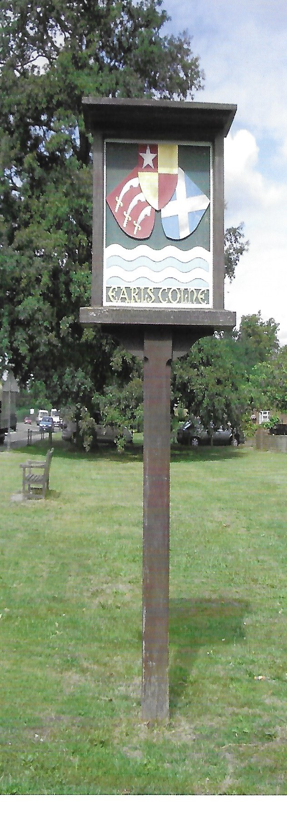
Earls Colne Neighbourhood Plan
Input from Students at Honywood School

Slide 2
Government Hierarchy
Central Government
(House of Commons & House of Lords)
National Laws, Public Spending, national policies, etc.
County Council
(e.g. Essex)
Schools, Police, Fire Service, Local Roads
Council Housing, Planning Applications, Leisure Facilities, Refuse Collection
District Council
(e.g. Braintree)
Local Community Assets, e.g. Village Hall, Community Land, War Memorial, Village Car Parks
Town & Parish Councils
(e.g. Halstead & Earls Colne)

Slide 3
Neighbourhood Plan Overview

Slide 4
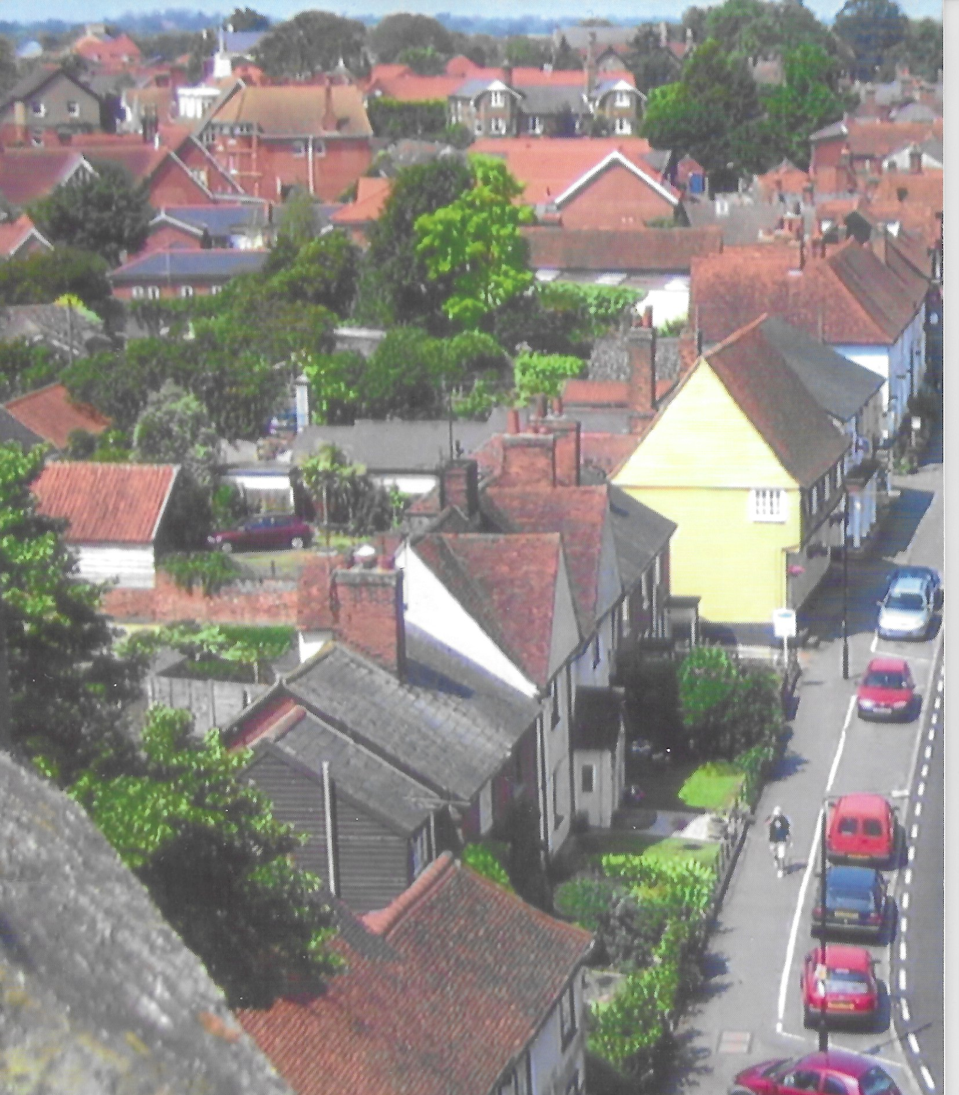
What is a Neighbourhood Plan?
The Neighbourhood Plan is part of a central government initiative introduced in 2011 under new legislation called the “Localism Act”
It allows small communities to have a greater say in how their local area evolves and allows residents to identify concerns and prioritise future investment
The plan has to be prepared by the Town or Parish Council together with volunteers from the local community and must be supported by the majority of residents
Before being finally adopted it is the subject of a referendum.

Slide 5
Why is a Neighbourhood Plan important for Earls Colne?
We are all aware there is increasing pressure from central government to build more and more new houses. (around 1,00 every year in the Braintree District alone)
We need greater influence on the location and nature of future developments in our village.
We need to have a say on the expansion of local services (education, health and recreation) to adequately serve a significantly increased population.

Slide 6
What is considered in the Neighbourhood Plan?
Aspect | Examples of what should be considered
Housing | Population, trends and projections Current housing stock, future needs and affordability Existing housing & development policies & strategies Site availability
Environment | Public open spaces and how they are used Landscape, flood plains and local drainage Existing environment and climate change policies
Economy | Local employment & skills Commuting patterns Different classes of existing local businesses
Community Facilities | Existing education, health, sport and recreational sites and buildings
Getting Around (Infrastructure) | Transport (footpaths, cycleways, footways and roads) Car ownership, traffic flows and congestion

Slide 7
Why is it important we have your views and ideas?
It’s vital that the plan includes input from all age groups in the village
It’s a long term plan with proposals for the village for the next 20 to 30 years
We recognise that different age groups may well have significantly differing views and ideas on priorities for the future. We need to capture as many opinions as possible.

Slide 8
So what do we want from you?
We would like you to arrange for Honywood students who lives in Earls Colne to fill out a short questionnaire giving their views on various aspects of life in the village.
We would then ask that you collate the results into a report giving the overall percentages of answers to each Yes or No question and to group and summarise the comments and suggestions received on the other questions.
Any observations or conclusions you wish to make on the results of the survey would also be very welcome

Slide 9
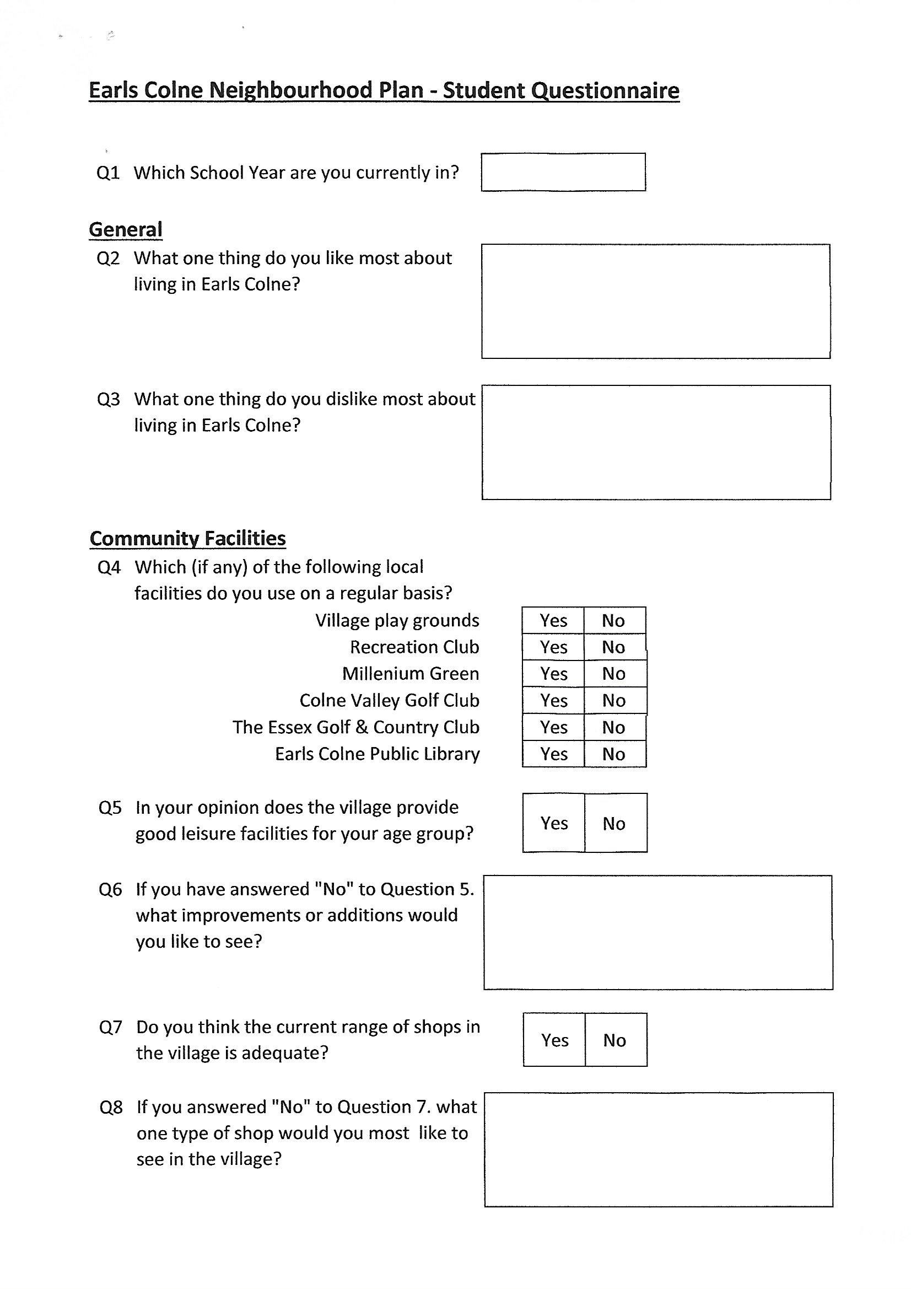
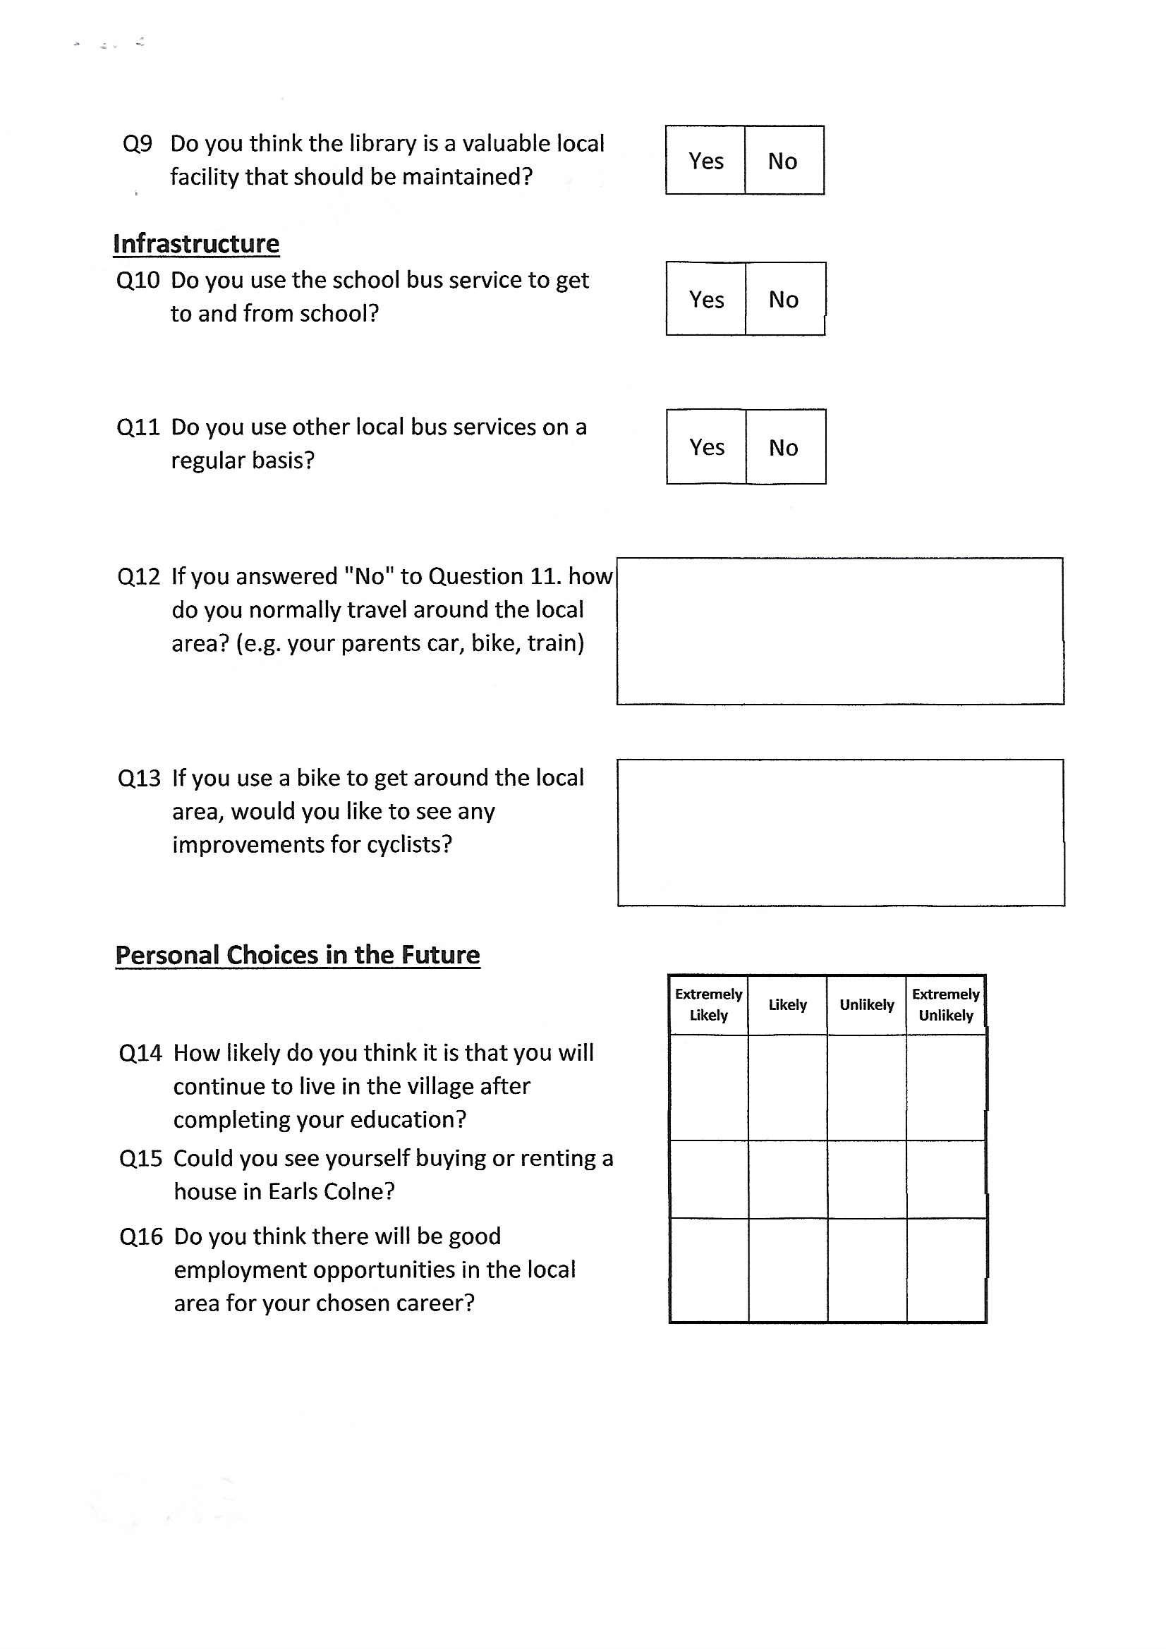
The Questionnaire

